Slide 1

ECE 603 Probability and Random Processes
Lessons 7-9
Chapter 4
Continuous and Mixed Random Variables
Notes:
Now: Slides with Annotation
Next: Slides with Annotation
*****Preparation Notes*****
Students taking this course should already have covered linear algebra elsewhere.
We will use linear algebra extensively in this course.

Slide 2
Objectives
Explore tools used and methods used to work with continuous random variables.
Examine mixed random variables that are mixtures of discrete and continuous random variables.
Notes:
Now: Slides with Annotation
Next: Slides with Annotation

Slide 3
Rationale
Consider that a continuous random variable X has a range in the form of an interval or a union of non-overlapping interview on the real line. This leads to the need for new tools to help you focus on continuous random variables.
The theory of continuous random variables is analogous to the theory of discrete random variables. So, you may take any formula about discrete random variables and replace sums with integrals to come up with the corresponding formula for continuous random variables.
Chapter 4 focuses on these relationships.
Chapter 4
Notes:
Now: Slides with Annotation
Next: Slides with Annotation

Slide 4
Prior Learning
Basic Concepts
Counting Methods
Random Variables
Access to the online textbook: https://www.probabilitycourse.com/
Chapter 4
Notes:
Now: Slides with Annotation
Next: Slides with Annotation

Slide 5



Continuous Random Variables
So far, we have discussed discrete random variables:
For a discrete random variable , , is a countable set, e.g.,
the CDF , looks like a series of steps with jumps at
Chapter 4
Notes:
Now: Slides with Annotation
Next: Slides with Annotation

Slide 6

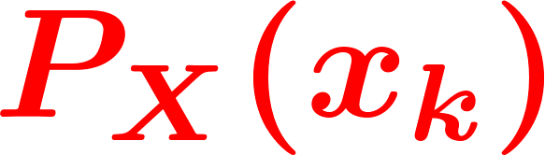
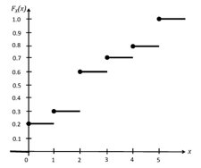
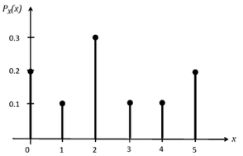
Discrete Random Variables: PMF & CDF
The jump at is given by the PMF
Chapter 4
Notes:
Now: Slides with Annotation
Next: Slides with Annotation

Slide 7
Cumulative Distributive Function (CDF)
Recall the general properties of a CDF:
Chapter 4
Notes:
Now: Slides with Annotation
Next: Slides with Annotation

Slide 8

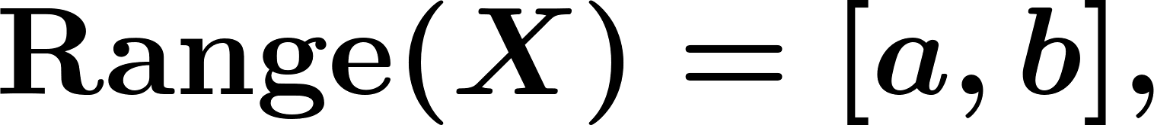


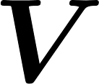
Continuous Random Variables
If is not countable then is not a discrete random variable.
Example.
Remember: etc.
Example.
: Lifetime of a light bulb,
: Voltage across a resistor,
Chapter 4
Notes:
Now: Slides with Annotation
Next: Slides with Annotation

Slide 9
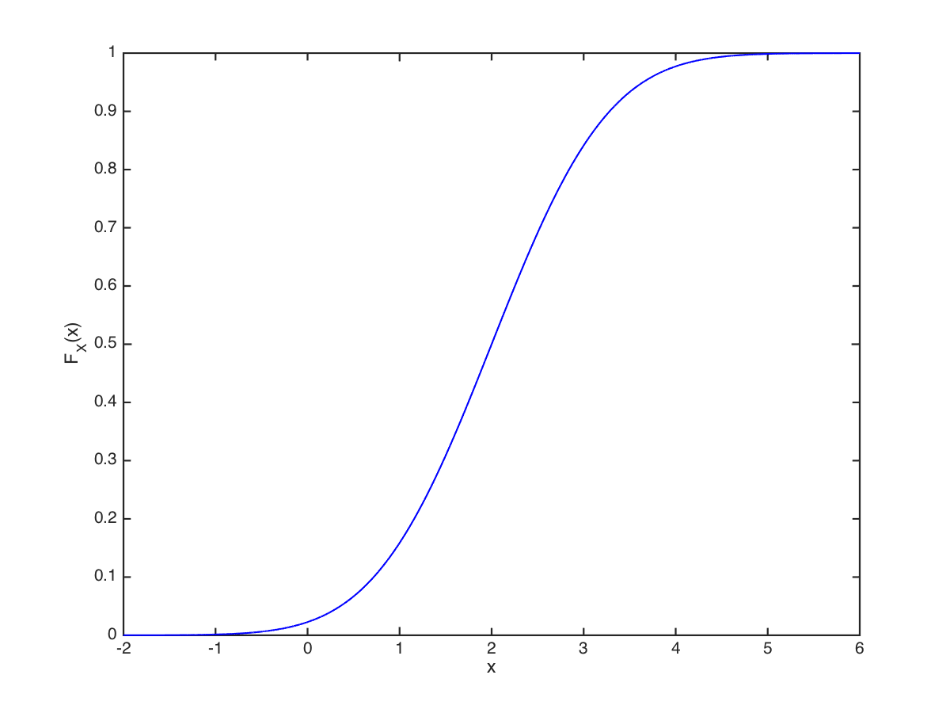
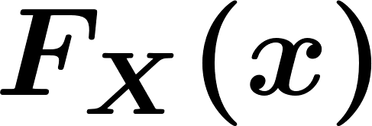
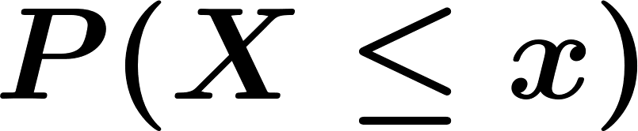
Continuous Random Variables
Now suppose we have a continuous function having those properties – for example:
A function like this is also a valid CDF . – that is, it can also represent . for some random variable .
Chapter 4
Notes:
Now: Slides with Annotation
Next: Slides with Annotation

Slide 10

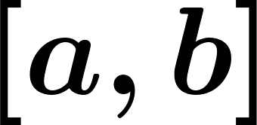


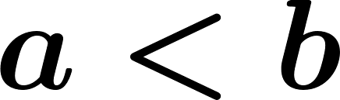
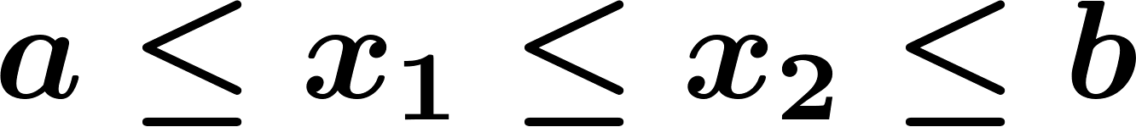
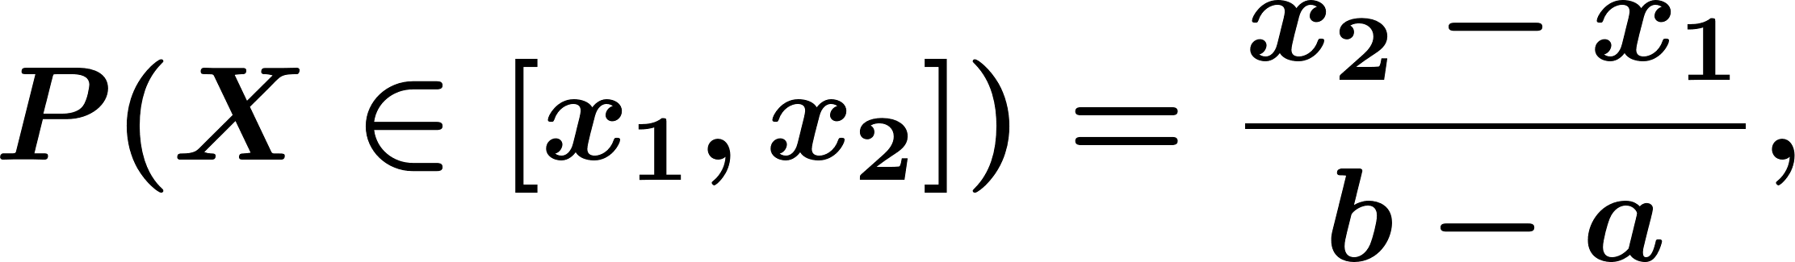
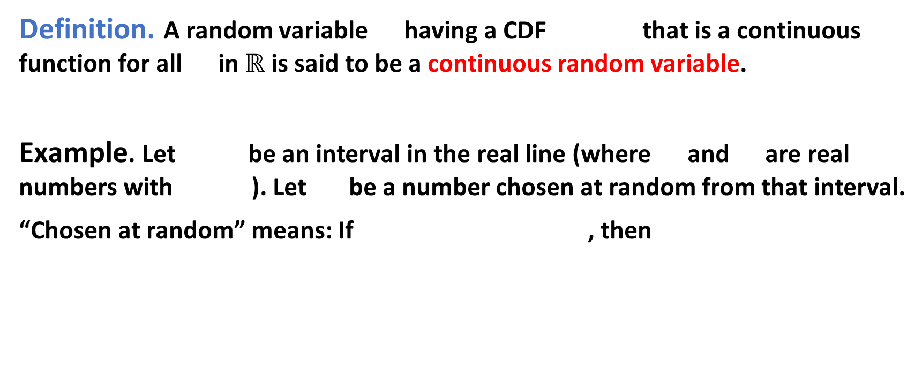
Continuous Random Variables
Definition. A random variable having a CDF that is a continuous function for all in $ℝ$ is said to be a continuous random variable.
Example. Let be an interval in the real line (where and are real numbers with ). Let be a number chosen at random from that interval.
“Chosen at random” means: If , then
Chapter 4
Notes:
Now: Slides with Annotation
Next: Slides with Annotation

Slide 11
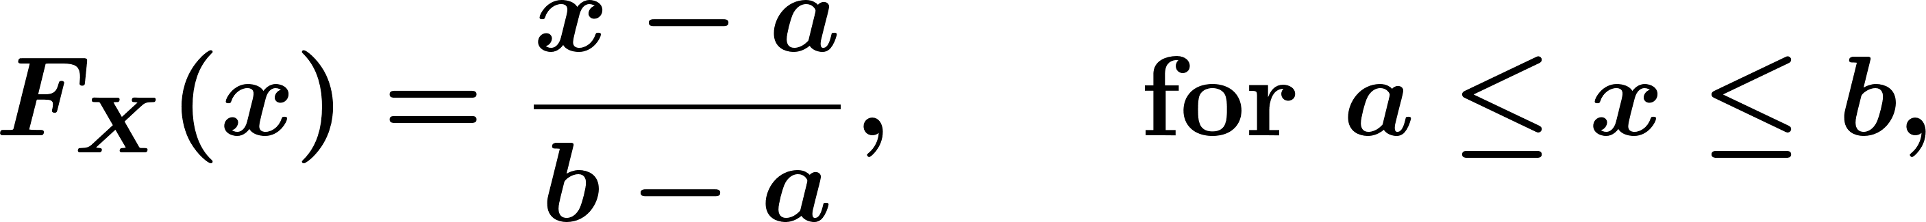
Continuous Random Variables
Let’s find the CDF
Chapter 4
Notes:
Now: Slides with Annotation
Next: Slides with Annotation

Slide 12
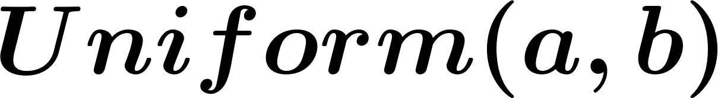
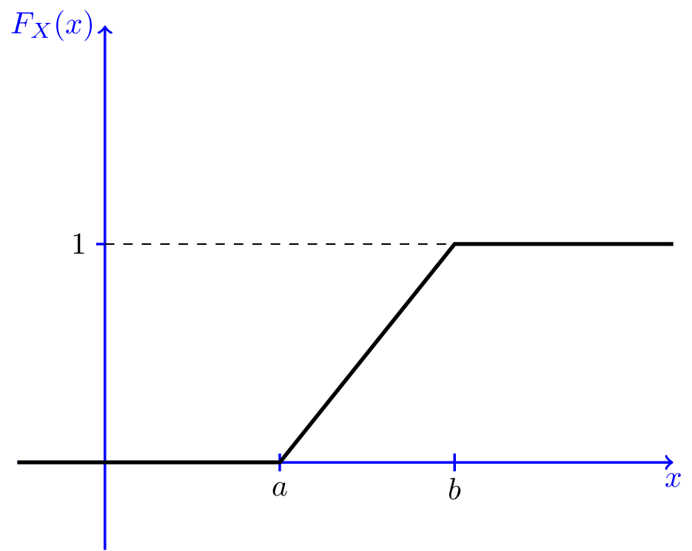
Continuous Random Variables
In this case, is called a random variable.
Chapter 4
Notes:
Now: Slides with Annotation
Next: Slides with Annotation

Slide 13
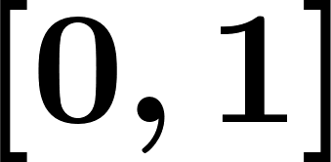


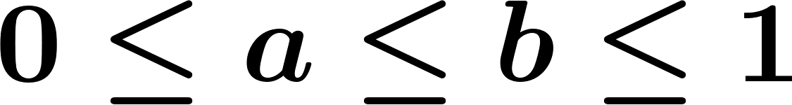
Continuous Random Variables
Example. Consider a line of length 1, i.e., . Place a dot at random on the line.
Location of the dot,
What is
What is
For , what is
Obtain the CDF of .
Chapter 4
Notes:
Now: Slides with Annotation
Next: Slides with Annotation

Slide 14
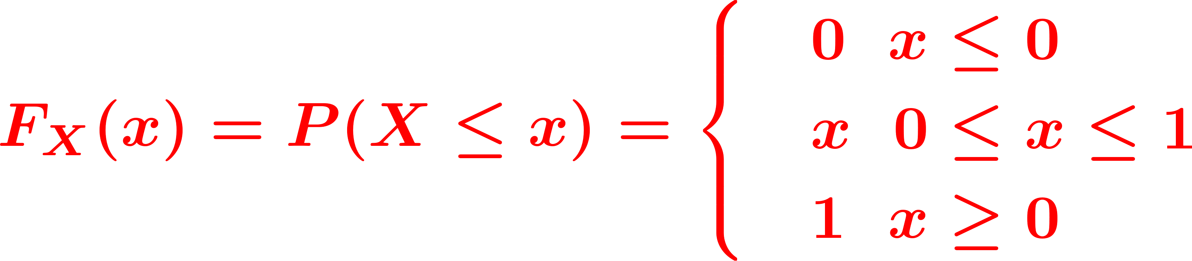

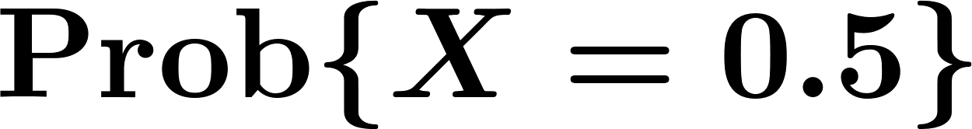

Continuous Random Variables
What is ? why?
Chapter 4
Notes:
Now: Slides with Annotation
Next: Slides with Annotation

Slide 15
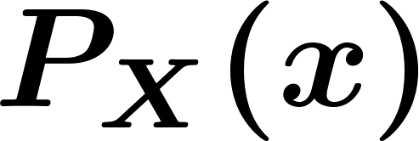
Continuous Random Variables
For a discrete random variable: the rate of increase in the CDF is characterized by the PMF - that is, by the locations and sizes of the jumps in the CDF.
What characterizes the rate of increase for a continuous function?
The derivative of the function
Chapter 4
Notes:
Now: Slides with Annotation
Next: Slides with Annotation

Slide 16
Continuous Random Variables
If the CDF is a continuous function, then is said to be a continuous random variable.
PMF is Not well-defined for continuous random variables. Instead, we define probability density function (pdf).
Chapter 4
Notes:
Now: Slides with Annotation
Next: Slides with Annotation

Slide 17
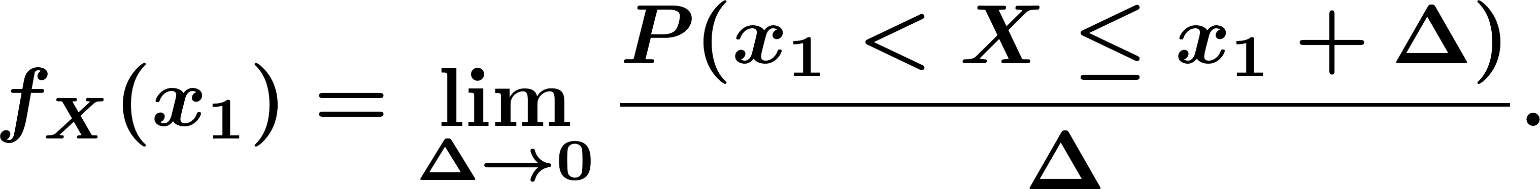
Probability Density Function (PDF)
Definition. pdf:
Remember that,
Chapter 4
Notes:
Now: Slides with Annotation
Next: Slides with Annotation

Slide 18
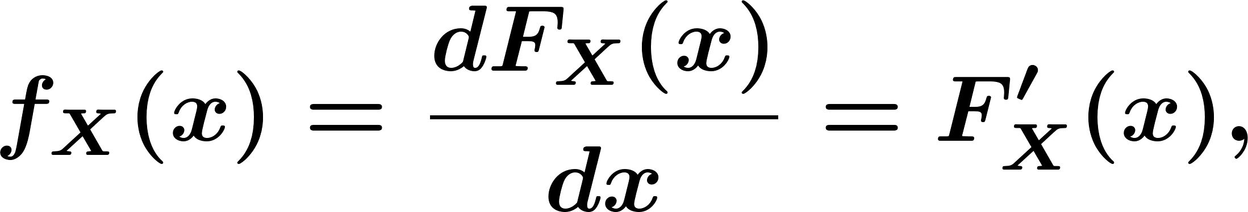
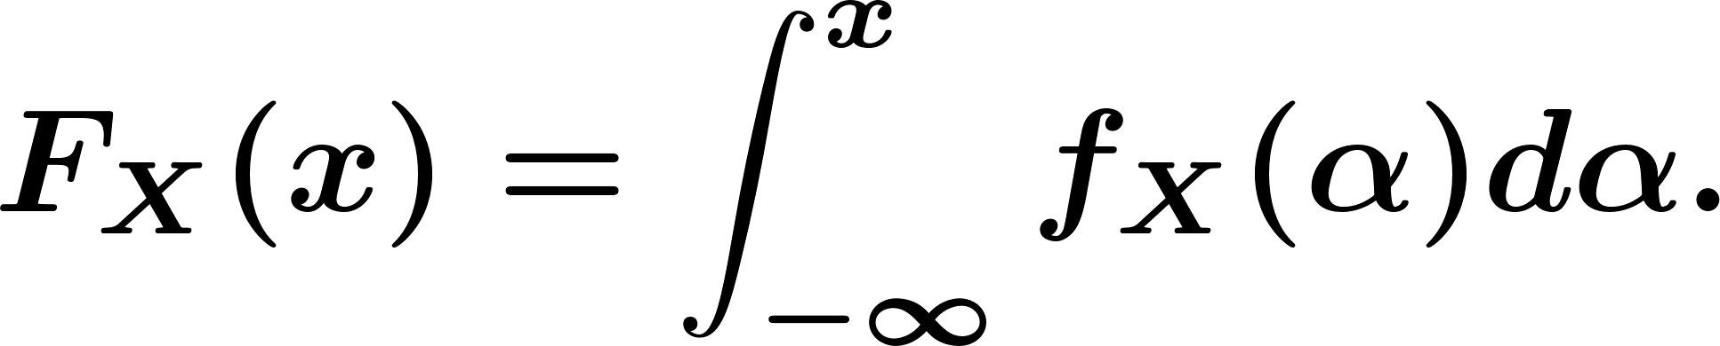
Probability Density Function (PDF)
Definition. Consider a continuous random variable with an absolutely continuous CDF . Then we have
is called the probability density function (PDF) of .
Chapter 4
Notes:
Now: Slides with Annotation
Next: Slides with Annotation

Slide 19
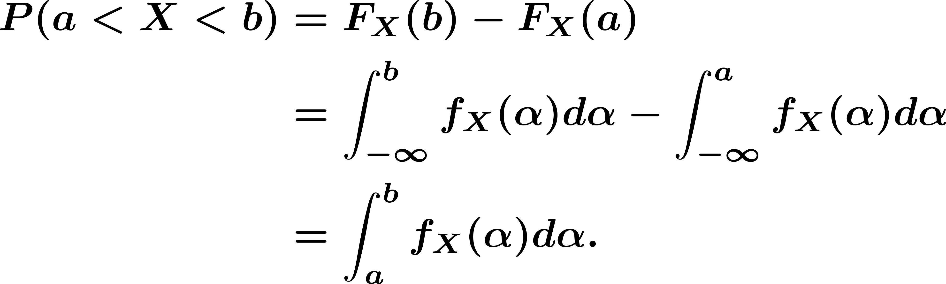
Probability Density Function (PDF)
Theorem.
Chapter 4
Notes:
Now: Slides with Annotation
Next: Slides with Annotation

Slide 20
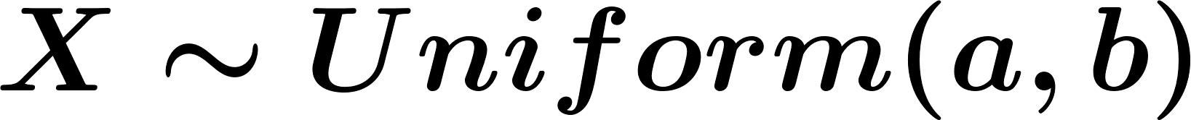
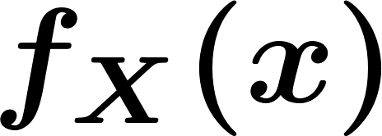
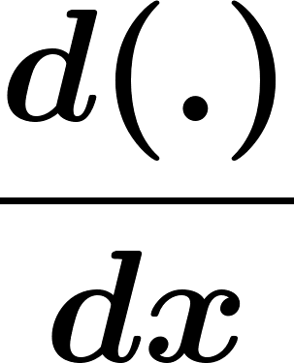
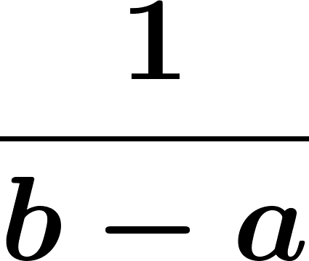

Probability Density Function (PDF)
Example. Say that .
Chapter 4
Notes:
Now: Slides with Annotation
Next: Slides with Annotation

Slide 21
Probability Density Function (PDF)
Back to our dot and line example:
Chapter 4
Notes:
Now: Slides with Annotation
Next: Slides with Annotation

Slide 22
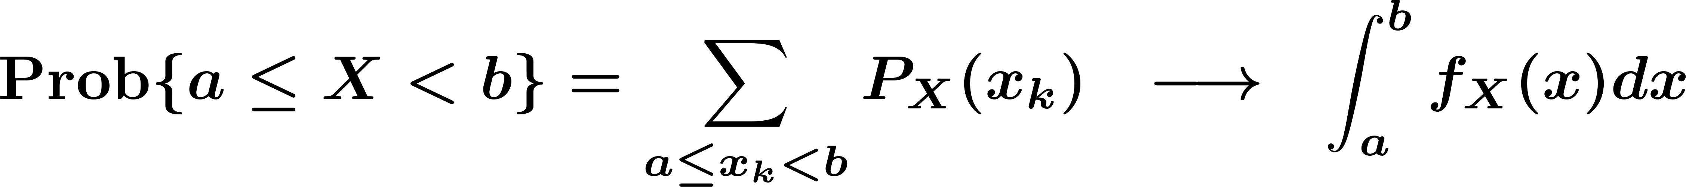
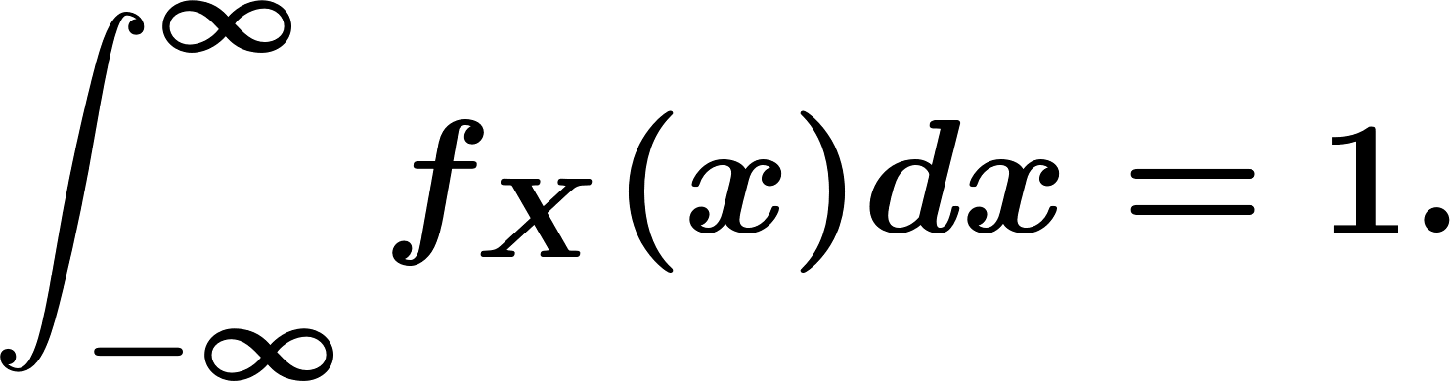
Probability Density Function (PDF)
Comparison with discrete random variable:
If we integrate over the entire real line, we must get 1, i.e.,
discrete
continuous
Chapter 4
Notes:
Now: Slides with Annotation
Next: Slides with Annotation

Slide 23
Probability Density Function (PDF)
In math: A density function for a quantity is a non-negative function that is integrated to give that quantity.
Let’s look at the properties of a PDF:
Since is monotone non-decreasing, its derivative must satisfy
Chapter 4
Notes:
Now: Slides with Annotation
Next: Slides with Annotation

Slide 24
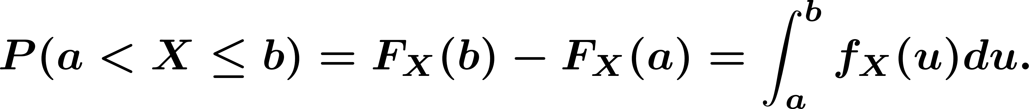
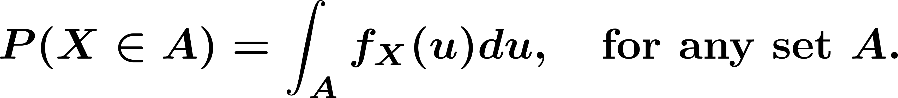
Probability Density Function (PDF)
In general:
We can extend the property 3 to:
Chapter 4
Notes:
Now: Slides with Annotation
Next: Slides with Annotation

Slide 25
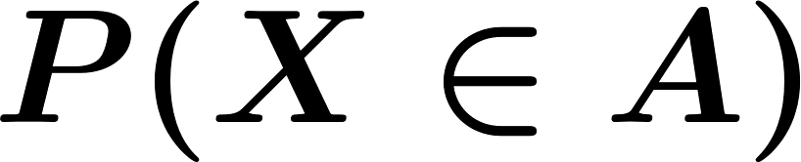
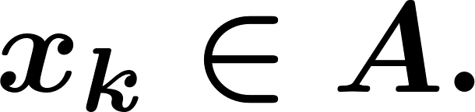

Probability Density Function (PDF)
So, for a discrete random variable having range to find . , we sum the PMF over the points
For a continuous random variable, to find , we integrate the PDF over the set .
Chapter 4
Notes:
Now: Slides with Annotation
Next: Slides with Annotation

Slide 26
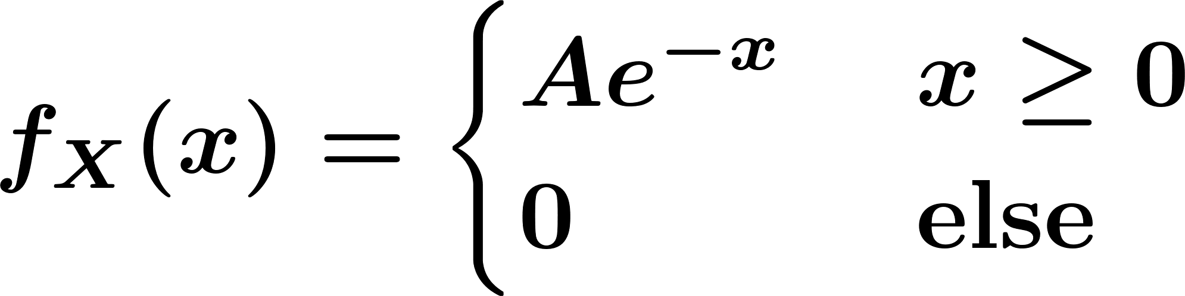
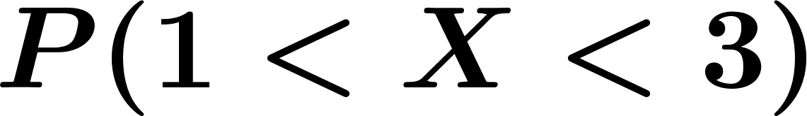
Probability Density Function (PDF)
Example. Let be a continuous random variable with the following PDF
Find .
Find .
Find .
Chapter 4
Notes:
Now: Slides with Annotation
Next: Slides with Annotation

Slide 27
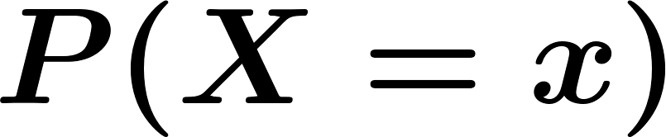
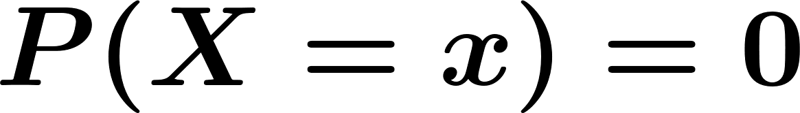
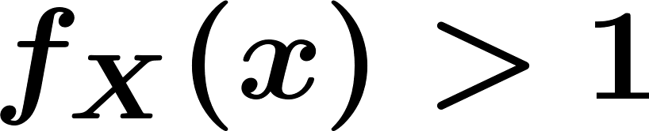
Probability Density Function (PDF)
Important note: is not equal to . In fact, for a continuous random variable we have for every point . Also, it is possible in general to have for some values of .
Chapter 4
Notes:
Now: Slides with Annotation
Next: Slides with Annotation

Slide 28
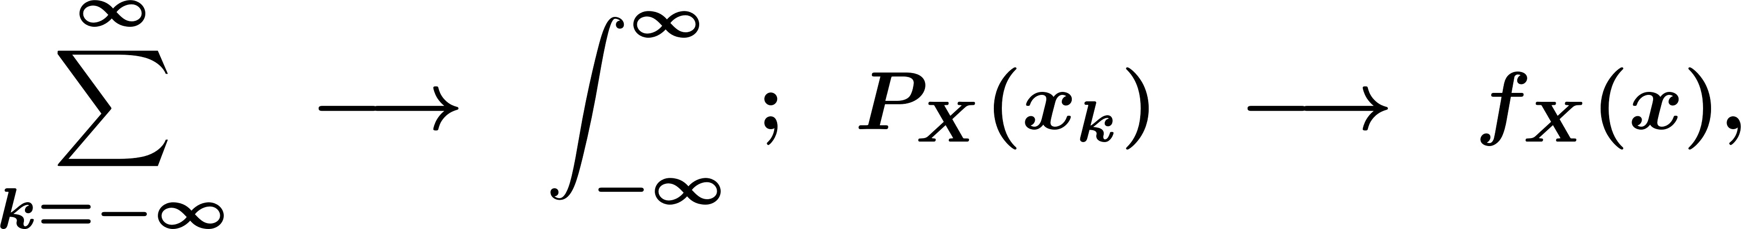
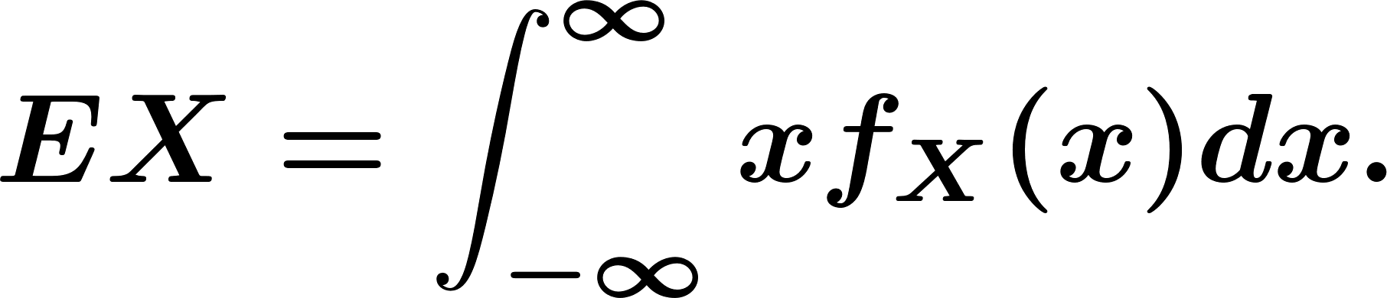
Expected Value and Variance
So, we get:
Chapter 4
Notes:
Now: Slides with Annotation
Next: Slides with Annotation

Slide 29
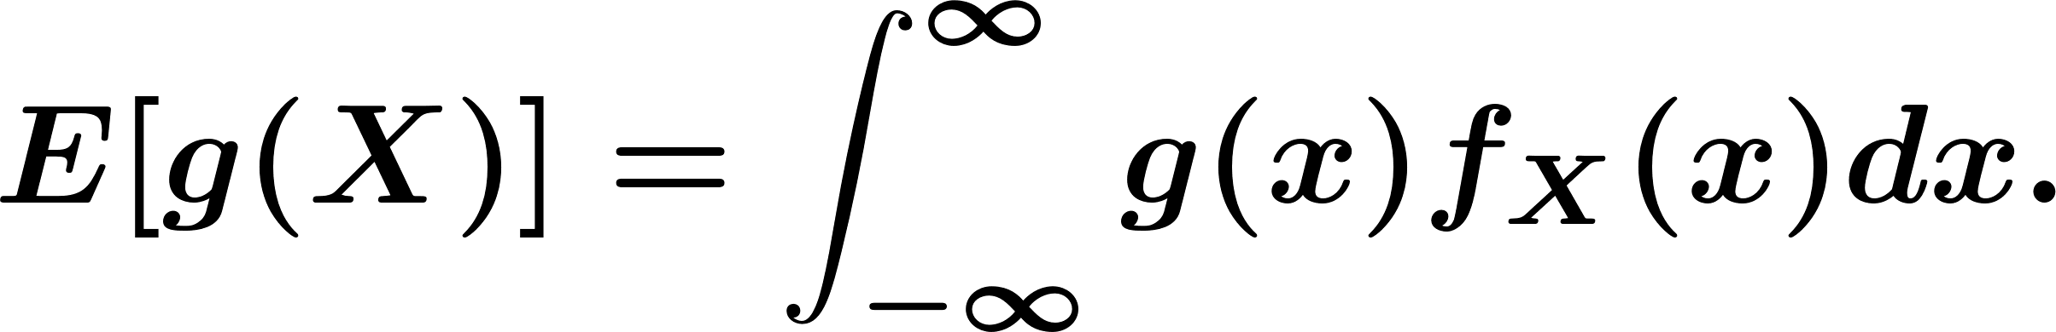
Expected Value and Variance
Law of the unconscious statistician (LOTUS) for continuous random variables:
Chapter 4
Notes:
Now: Slides with Annotation
Next: Slides with Annotation

Slide 30
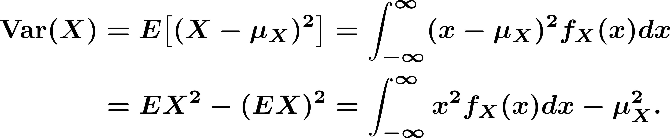
Expected Value and Variance
Remember that the variance of any random variable is defined as
So for a continuous random variable, we can write
Chapter 4
Notes:
Now: Slides with Annotation
Next: Slides with Annotation

Slide 31
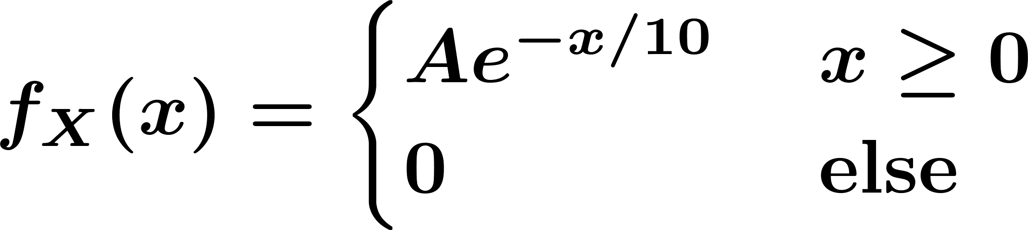


Expected Value and Variance
Example. In a medical ultrasound system, the energy in a pulse scattered by diffuse reflectors is a random variable having a pdf of the form:
Find the value of
Find
Chapter 4
Notes:
Now: Slides with Annotation
Next: Slides with Annotation

Slide 32
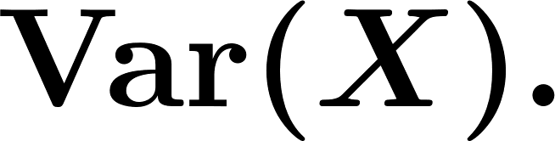
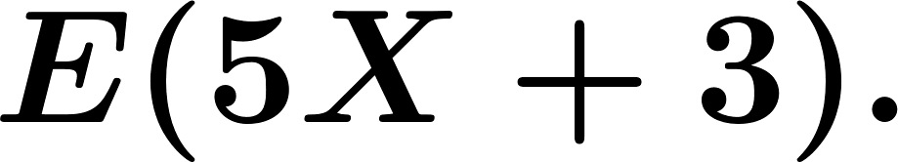
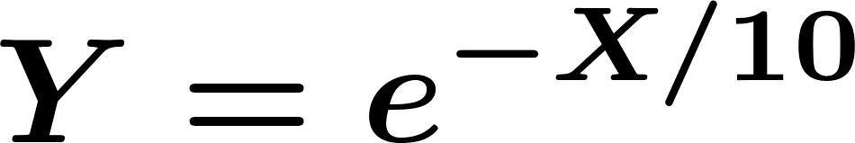

Expected Value and Variance
Find
Find
Let , find
Chapter 4
Notes:
Now: Slides with Annotation
Next: Slides with Annotation

Slide 33
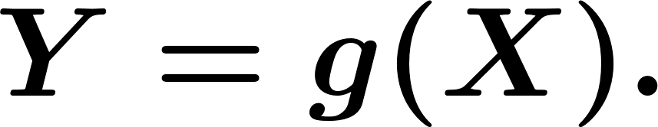


Functions of Continuous Random Variables
Suppose that is a continuous random variable having CDF and PDF . . Let be some function, and let
Since is a random variable, so is . We already know that we can find by
Chapter 4
Notes:
Now: Slides with Annotation
Next: Slides with Annotation

Slide 34
Functions of Continuous Random Variables
Question: How do we find the CDF and PDF for ?
Usually: It is easier to first find the CDF for , and then take the derivative to find the PDF.
Chapter 4
Notes:
Now: Slides with Annotation
Next: Slides with Annotation

Slide 35
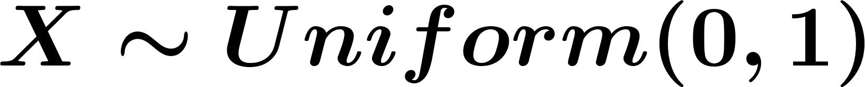


Functions of Continuous Random Variables
Example. Suppose that and .
Find the CDF and PDF of .
Note that:
Chapter 4
Notes:
Now: Slides with Annotation
Next: Slides with Annotation

Slide 36


Functions of Continuous Random Variables
Example. Suppose that and .
Find the CDF and PDF of .
Note that:
Chapter 4
Notes:
Now: Slides with Annotation
Next: Slides with Annotation

Slide 37

Functions of Continuous Random Variables
There’s another approach called the Method of Transformations that sometimes gives a quicker way of finding directly from .
Chapter 4
Notes:
Now: Slides with Annotation
Next: Slides with Annotation

Slide 38



Functions of Continuous Random Variables
If is a continuous random variable and is a function of , then itself is a random variable.
Steps:
Find
Find CDF of
Find
Chapter 4
Notes:
Now: Slides with Annotation
Next: Slides with Annotation

Slide 39


Functions of Continuous Random Variables
Example. Now suppose that and
Find CDF and PDF of
Chapter 4
Notes:
Now: Slides with Annotation
Next: Slides with Annotation

Slide 40




Summary of Continuous Random Variable
PDF:
Expected Value:
LOTUS:
Chapter 4
Notes:
Now: Slides with Annotation
Next: Slides with Annotation

Slide 41
Summary of Continuous Random Variable
Definition. Consider a continuous random variable with an absolutely continuous CDF . The function defined by
Chapter 4
Notes:
Now: Slides with Annotation
Next: Slides with Annotation

Slide 42




Summary of Continuous Random Variable
Consider a continuous random variable with PDF . We have
More generally, for a set ,
Chapter 4
Notes:
Now: Slides with Annotation
Next: Slides with Annotation

Slide 43





Summary of Continuous Random Variable
Discrete RVs Continuous RVs
PMF PDF
Chapter 4
Notes:
Now: Slides with Annotation
Next: Slides with Annotation

Slide 44
Summary of Continuous Random Variable
Functions of Continuous RVs:
Steps:
Read method of Transformations (4.1.3).
Chapter 4
Notes:
Now: Slides with Annotation
Next: Slides with Annotation

Slide 45



Special Distributions
Uniform Distribution:
Chapter 4
Notes:
Now: Slides with Annotation
Next: Slides with Annotation

Slide 46


Special Distributions
Example. Let
Chapter 4
Notes:
Now: Slides with Annotation
Next: Slides with Annotation

Slide 47




Special Distributions
Exponential Distribution:
Where denote the unit step function.
Chapter 4
Notes:
Now: Slides with Annotation
Next: Slides with Annotation

Slide 48


Special Distributions
We find the CDF using the equation
So
Chapter 4
Notes:
Now: Slides with Annotation
Next: Slides with Annotation

Slide 49


Special Distributions
Example. CDF of
Chapter 4
Notes:
Now: Slides with Annotation
Next: Slides with Annotation

Slide 50

Special Distributions
Expected value
Chapter 4
Notes:
Now: Slides with Annotation
Next: Slides with Annotation

Slide 51



Special Distributions
Thus, we obtain
Chapter 4
Notes:
Now: Slides with Annotation
Next: Slides with Annotation

Slide 52

Special Distributions
If , then
Chapter 4
Notes:
Now: Slides with Annotation
Next: Slides with Annotation

Slide 53







Special Distributions
If is exponential with parameter , then is a memoryless random variable, that is
Chapter 4
Notes:
Now: Slides with Annotation
Next: Slides with Annotation

Slide 54

Special Distributions
Proof:
Chapter 4
Notes:
Now: Slides with Annotation
Next: Slides with Annotation

Slide 55


Special Distributions
Exponential random variables are often used to model times between arrivals at service centers (these are called interarrival times) – the memoryless property says that no matter how long you have waited for an arrival ( ), the probability that you will have to wait for more than more time instants is always (that is, it doesn’t depend on ).
Chapter 4
Notes:
Now: Slides with Annotation
Next: Slides with Annotation

Slide 56
Special Distributions
Normal (Gaussian) Distribution:
The normal distribution is by far the most important probability distribution. One of the main reasons for that is the Central Limit Theorem (CLT).
Chapter 4
Notes:
Now: Slides with Annotation
Next: Slides with Annotation

Slide 57
Special Distributions
As we’ll see later: The Central Limit Theorem says that random variables that are formed as sums of many independent random variables have distributions that are approximately Gaussian (e.g., the random voltage caused by electronic noise that results from the summed contributions of a very large number of randomly-located charge carriers).
Chapter 4
Notes:
Now: Slides with Annotation
Next: Slides with Annotation

Slide 58



Special Distributions
Standard normal random variable:
Chapter 4
Notes:
Now: Slides with Annotation
Next: Slides with Annotation

Slide 59




Special Distributions
Expected value of the standard normal:
Since is and odd function.
Chapter 4
Notes:
Now: Slides with Annotation
Next: Slides with Annotation

Slide 60




Special Distributions
Variance of the standard normal:
Integration by parts.
Chapter 4
Notes:
Now: Slides with Annotation
Next: Slides with Annotation

Slide 61



Special Distributions
CDF of the standard normal: The CDF of the standard normal distribution is denoted by the function.
Chapter 4
Notes:
Now: Slides with Annotation
Next: Slides with Annotation

Slide 62





Special Distributions
Here are some properties of the function:
Chapter 4
Notes:
Now: Slides with Annotation
Next: Slides with Annotation

Slide 63


Special Distributions
The standard normal CDF can’t be evaluated in closed form (except at a few specific values of ), but numerical approximations are widely available (e.g., the normcdf command in MATLAB).
Chapter 4
Notes:
Now: Slides with Annotation
Next: Slides with Annotation

Slide 64


Special Distributions
General Normal random variables:
Chapter 4
Notes:
Now: Slides with Annotation
Next: Slides with Annotation

Slide 65


Special Distributions
General Normal random variables:
Chapter 4
Notes:
Now: Slides with Annotation
Next: Slides with Annotation

Slide 66


Special Distributions
CDF and PDF of Normal random variables ( ):
Chapter 4
Notes:
Now: Slides with Annotation
Next: Slides with Annotation

Slide 67


Special Distributions
If ,
Chapter 4
Notes:
Now: Slides with Annotation
Next: Slides with Annotation

Slide 68






Special Distributions
Example. PDF (top) and CDF (bottom) of random variable (left) and . random variable (right):
Chapter 4
Notes:
Now: Slides with Annotation
Next: Slides with Annotation

Slide 69


Special Distributions
Example. Say that , find
Chapter 4
Notes:
Now: Slides with Annotation
Next: Slides with Annotation

Slide 70


Special Distributions
Example. The IQ of randomly selected individuals is often assumed to follow a Normal distribution with mean and standard deviation . Find the probability that a randomly selected individual has an IQ:
Above 140
Between 120 and 130
Find the value of such that 99% of the population has IQ at least .
Chapter 4
Notes:
Now: Slides with Annotation
Next: Slides with Annotation

Slide 71



Special Distributions
Note: In MATLAB, the command calculates
So, for example: If and we want to calculate we can use the command:
Chapter 4
Notes:
Now: Slides with Annotation
Next: Slides with Annotation

Slide 72


Special Distributions
Example. Suppose that . Then:
Chapter 4
Notes:
Now: Slides with Annotation
Next: Slides with Annotation

Slide 73

Special Distributions
Chapter 4
Notes:
Now: Slides with Annotation
Next: Slides with Annotation

Slide 74
Special Distributions
So, the probability that a Gaussian random variable takes a value within 1 standard deviation from its mean is 0.6827.
The probability that a Gaussian random variable takes a value within 3 standard deviations from its mean is 0.9973.
Chapter 4
Notes:
Now: Slides with Annotation
Next: Slides with Annotation

Slide 75




Special Distributions
Theorem. If , and , where , then
, where
Chapter 4
Notes:
Now: Slides with Annotation
Next: Slides with Annotation

Slide 76


Special Distributions
Example. Suppose that , and let .
Find
Chapter 4
Notes:
Now: Slides with Annotation
Next: Slides with Annotation

Slide 77



Gamma Distribution
Gamma function:
Chapter 4
Notes:
Now: Slides with Annotation
Next: Slides with Annotation

Slide 78


Gamma Distribution
Gamma Distribution:
If
Chapter 4
Notes:
Now: Slides with Annotation
Next: Slides with Annotation

Slide 79

Gamma Distribution
If are independent, then
Chapter 4
Notes:
Now: Slides with Annotation
Next: Slides with Annotation

Slide 80
Mixed Random Variables
We will:
Define PDF (generalized PDF) for discrete random variables by using the delta function.
Introduce mixed random variables.
Chapter 4
Notes:
Now: Slides with Annotation
Next: Slides with Annotation

Slide 81

Mixed Random Variables
CDF for discrete RVs
Chapter 4
Notes:
Now: Slides with Annotation
Next: Slides with Annotation

Slide 82



Mixed Random Variables
Idea: Define the “derivative” of and that we can extend the PDF to the discrete RVs.
delta function
Chapter 4
Notes:
Now: Slides with Annotation
Next: Slides with Annotation

Slide 83






Mixed Random Variables
Delta function:
Where is small.
Chapter 4
Notes:
Now: Slides with Annotation
Next: Slides with Annotation

Slide 84


Mixed Random Variables
Chapter 4
Notes:
Now: Slides with Annotation
Next: Slides with Annotation

Slide 85





Mixed Random Variables
Lemma. Let be a continuous function. We have
Proof:
Chapter 4
Notes:
Now: Slides with Annotation
Next: Slides with Annotation

Slide 86


Mixed Random Variables
Example. Let
Chapter 4
Notes:
Now: Slides with Annotation
Next: Slides with Annotation

Slide 87



Mixed Random Variables
Definition: Properties of the delta function
We define the delta function as an object with the following properties:
, where is the unit step function.
for any
Chapter 4
Notes:
Now: Slides with Annotation
Next: Slides with Annotation

Slide 88



Mixed Random Variables
For any and any function that is continuous over , we have
Chapter 4
Notes:
Now: Slides with Annotation
Next: Slides with Annotation

Slide 89







Mixed Random Variables
Discrete Random Variable
Chapter 4
Notes:
Now: Slides with Annotation
Next: Slides with Annotation

Slide 90





Mixed Random Variables
generalized PDF
Chapter 4
Notes:
Now: Slides with Annotation
Next: Slides with Annotation

Slide 91


Mixed Random Variables
For a discrete random variable with range and PMF
, we define the (generalized) probability density function (PDF) as
Chapter 4
Notes:
Now: Slides with Annotation
Next: Orchestrated Conversation

Slide 92



Orchestrated Conversation: Mixed Random Variables
Is it true ?
Chapter 4
Notes:
Now: Orchestrated Conversation
Next: Slides with Annotation

Slide 93



Mixed Random Variables
Example.
Chapter 4
Notes:
Now: Slides with Annotation
Next: Slides with Annotation

Slide 94

Mixed Random Variables
Random variables:
Discrete
Continuous
Mixed random variable
Chapter 4
Notes:
Now: Slides with Annotation
Next: Slides with Annotation

Slide 95




Mixed Random Variables
The (generalized) PDF of a mixed random variable can be written in the form
where , and does not contain any delta functions. Furthermore, we have
Continuous
Discrete
Chapter 4
Notes:
Now: Slides with Annotation
Next: Slides with Annotation

Slide 96






Mixed Random Variables
Example. Let
Chapter 4
Notes:
Now: Slides with Annotation
Next: Slides with Annotation

Slide 97


Mixed Random Variables
Find the CDF of .
Find the generalized PDF of .
Find and .
Chapter 4
Notes:
Now: Slides with Annotation
Next: Slides with Annotation

Slide 98

Mixed Random Variables
So mixed random variable:
Discrete part
Continuous part
Chapter 4
Notes:
Now: Slides with Annotation
Next: Slides with Annotation

Slide 99



Orchestrated Conversation: Mixed Random Variables
Example. Let
Find and .
Find .
Find .
Find and .
Chapter 4
Notes:
Now: Slides with Annotation
Next: Slides with Annotation

Slide 100
Post-work for Lesson
Complete homework assignment for Lessons 7-9: HW#4 and HW#5
Go to the online classroom for details.
Chapter 4
Notes:
Now: Slides with Annotation
Next: Slides with Annotation

Slide 101
To Prepare for the Next Lesson
Read Chapter 5 in your online textbook:
https://www.probabilitycourse.com/chapter5/5_1_0_joint_distributions.php
Complete the Pre-work for Lessons 10-13.
Visit the online classroom for details.
Chapter 4
Notes:
Now: Slides with Annotation

